Slide 1
re:Button
Physical Computing meets AI

Slide 2
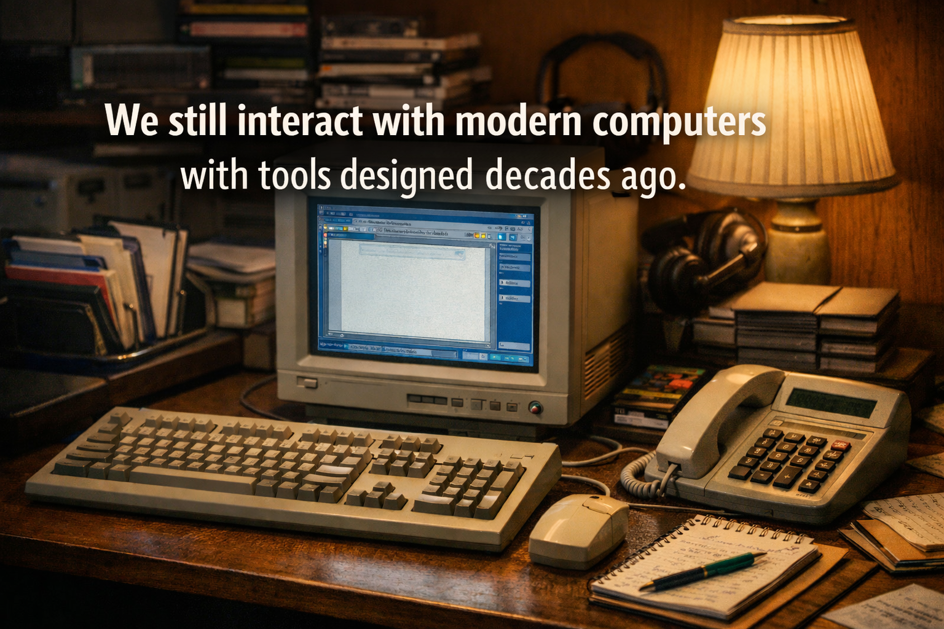

Slide 3
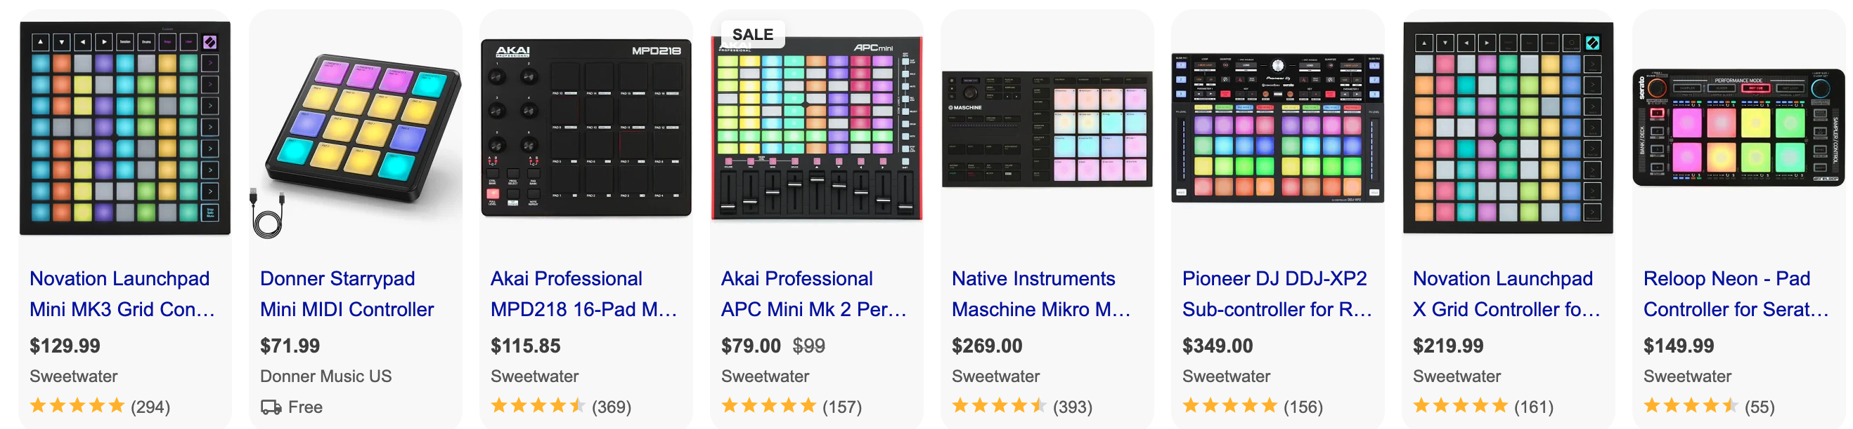

Slide 4
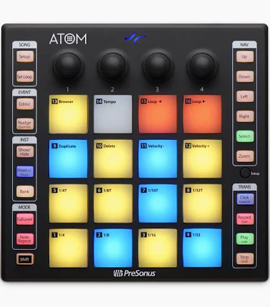

Slide 5
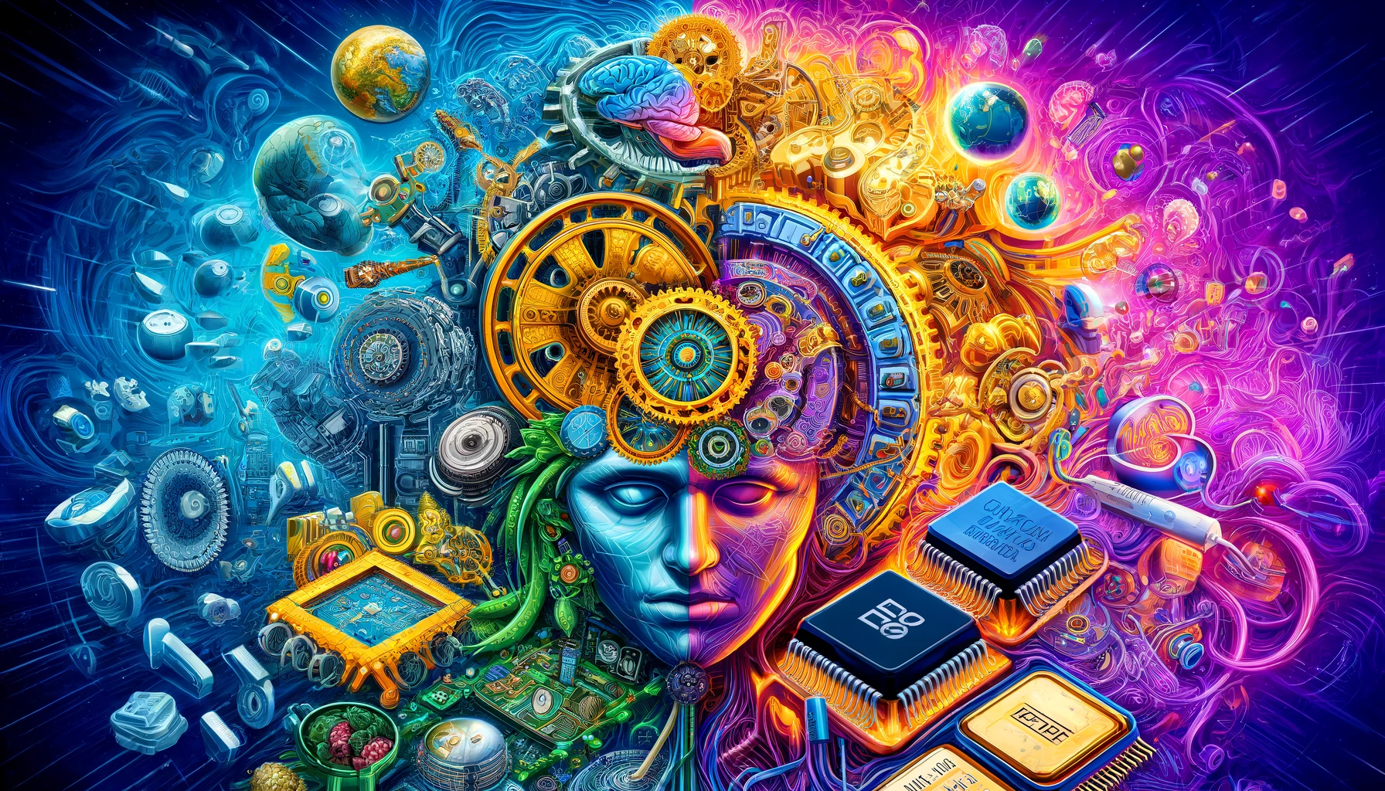

The Renaissance Developer

Slide 6


Modernization Demo
https://bit.ly/modern-ai
Notes:
Autonomous Agent

Slide 7
1. Whatsapp MCP Bridge: From GO to Java!
2. REST to MCP with Kiro and IoT
3. re:Button Project
Notes:
Autonomous Agent

Slide 8
Introduction to re:Money
Notes:
Autonomous Agent

Slide 9
The Computer Renaissance
Renascent Data
Renascent Software
Renascent Intelligence
Renascent Devices
Notes:
So, if you remember one thing, let it be this. Stop. using. JDK8. And. JDK11., JDK8 and 11 are in “maintenance mode”, meaning that it only gets security backports and not efficiency improvements. It’s time to move on.
Old java can be danger to your business: data leak (log4j, jboss 4.2.2 -> mining)

Slide 10

Get started with Kiro for free
Kiro.dev
Notes:
Scaling AI-Assisted Development
Current AI coding assistants work well for small tasks but break down with complex projects
"Vibe coding" approaches are seen as suitable for small, less complex projects, not production-grade work
Developers often spend as much time guiding AI and fixing issues as they would coding from scratch
Limited Interaction Modalities
Existing interfaces (inline coding and chat) lack end-to-end user experience for monitoring and intervening in agent actions
Current tools require step-by-step prompting for each task, which doesn't scale across tasks or teams
Developers need a more comprehensive interface that combines natural language, architecture diagrams, UX designs, chat, and code
Maintaining Code Quality with AI Assistance
As projects grow, critical tasks like documentation, testing, refactoring, and performance optimization become challenging
Developers struggle to delegate these tasks to AI agents while maintaining control and ensuring quality
Existing tools don't provide intuitive ways to verify that AI-generated work meets developers' quality standards

Slide 11

Vinicius Senger
vsenger@amazon.com
@SiliconVini
bit.ly/intro-to-remoney
bit.ly/modern-ai
kiro.dev
Thank you!

